Slide 1
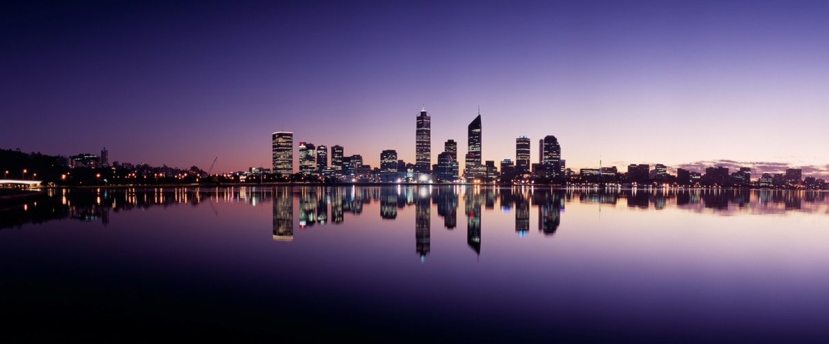
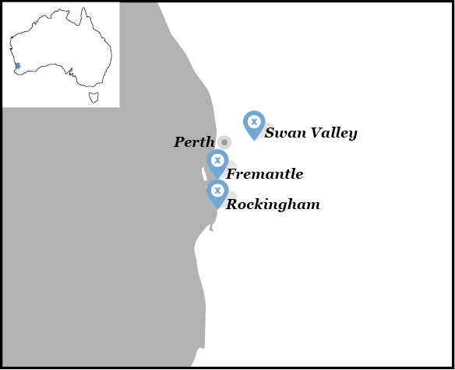
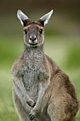
Proposal to host IOCCG-22 in Perth, Western Australia 2017
Nick Hardman-Mountford, CSIRO
David Antoine, Curtin University

Slide 2
Venue options
New Indian Ocean Marine Research Centre on UWA campus: banks of River Swan, conference facilities and accommodation on site
Fraser’s Restaurant and Conference Facility, Kings Park:
bushland park location with river views, near CBD, accommodation in West Perth / Perth City, good for accessing Perth Festival and Fringe
Cottesloe Beach Hotel:
iconic beach location, range of cafes and restaurants, a little out of the city
Outliers - Rottnest Island / Swan Valley Wineries:
retreat locations – not scoped

Slide 3
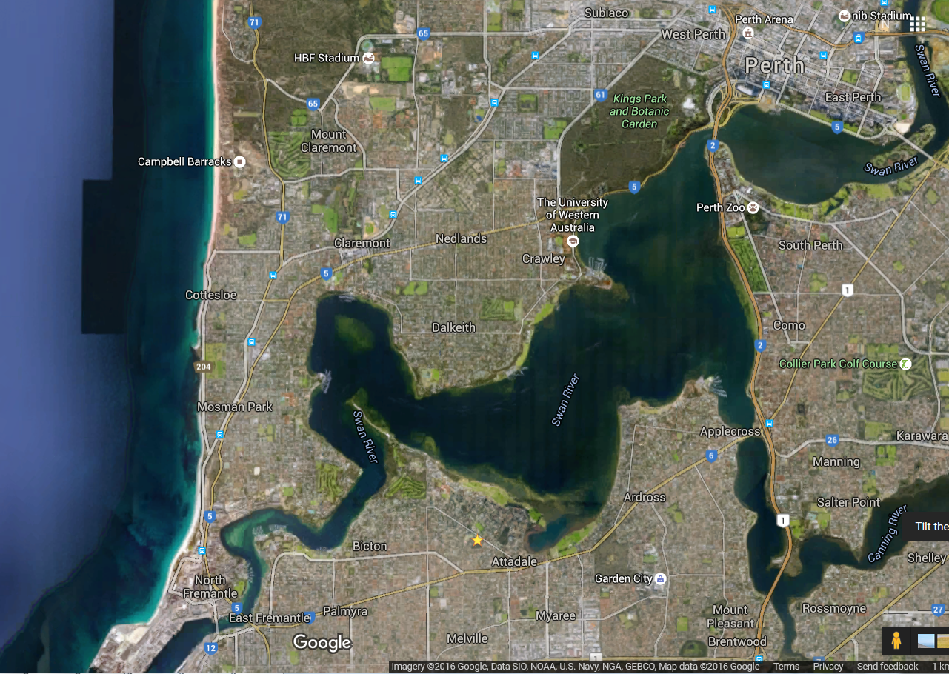
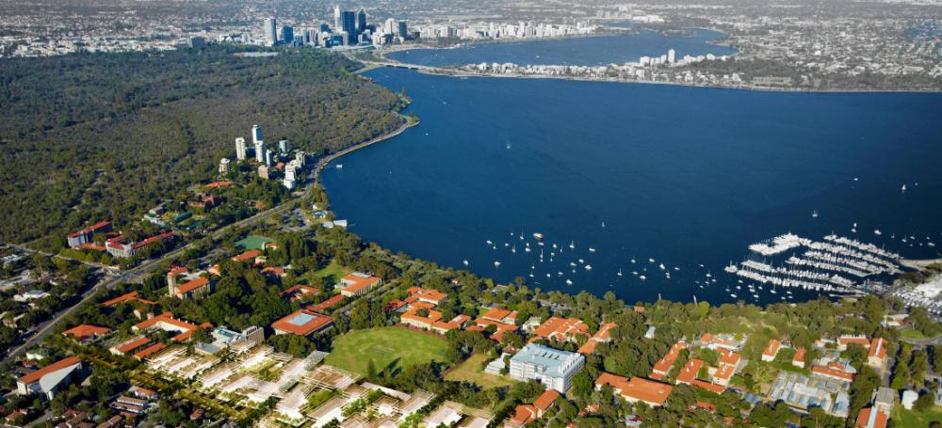
Location of venues
Airport ~20-30 mins
1km

Slide 4
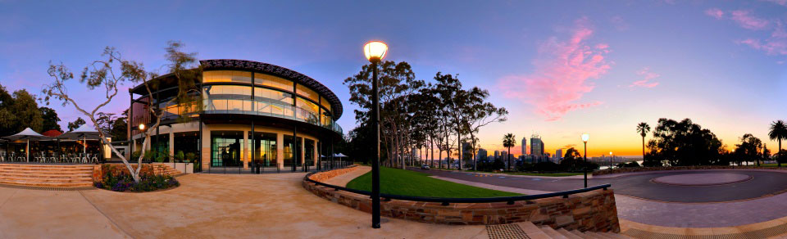
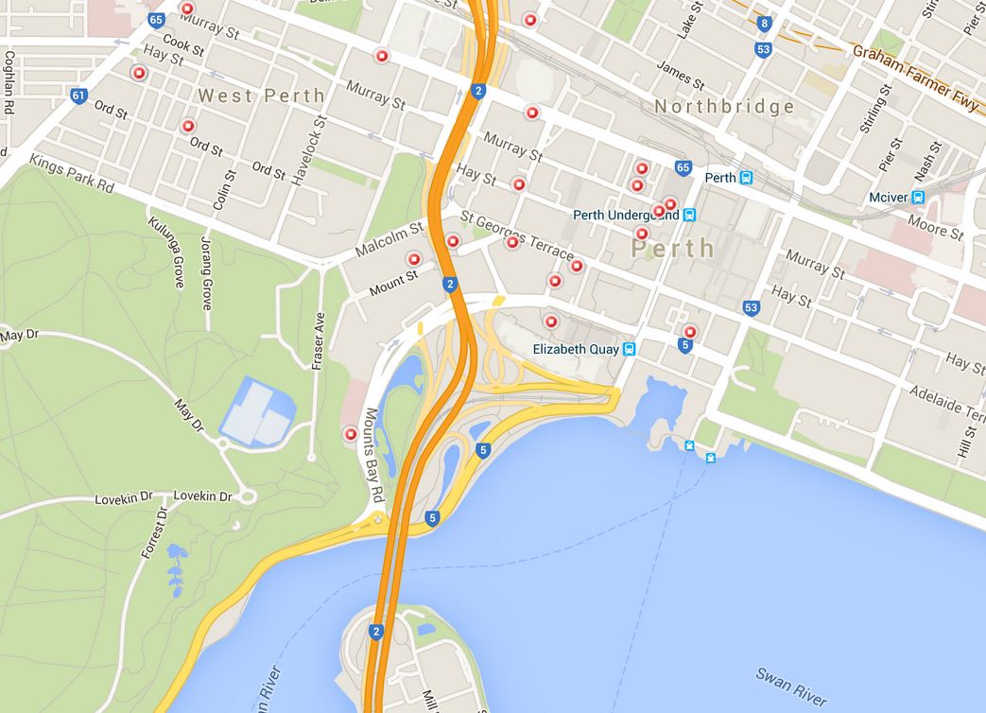
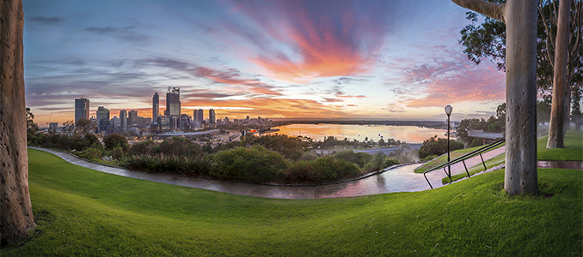
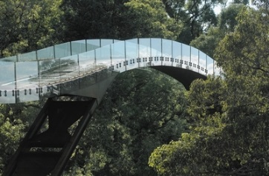
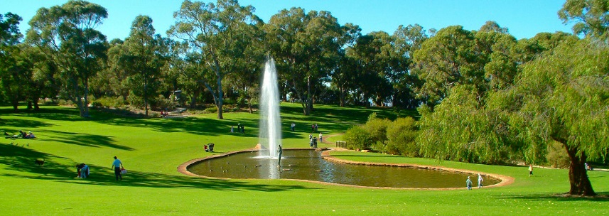
Fraser’s – Kings Park
Nearby hotels

Slide 5
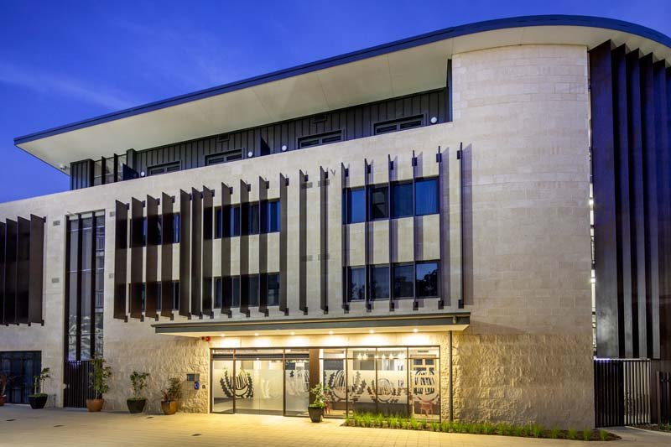
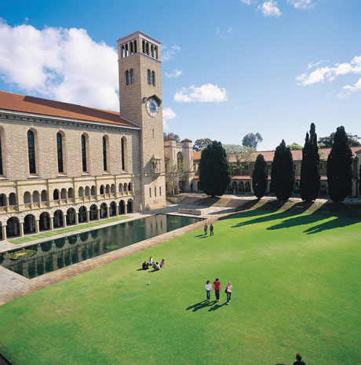
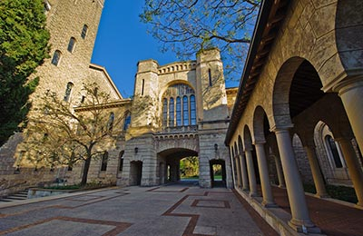
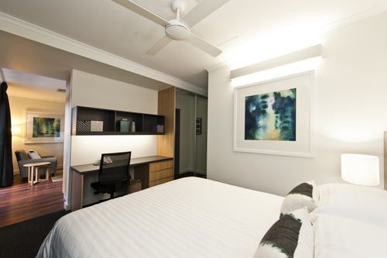
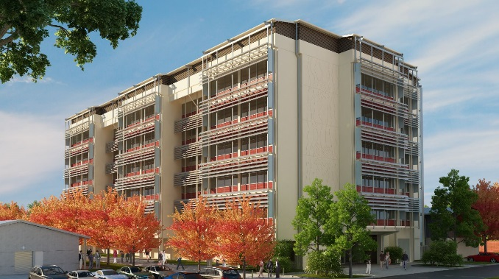
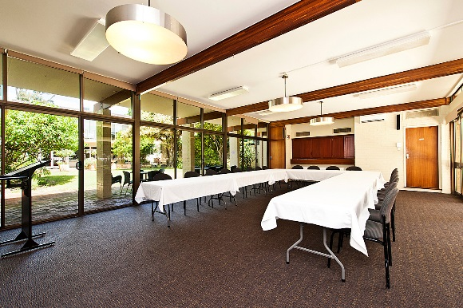
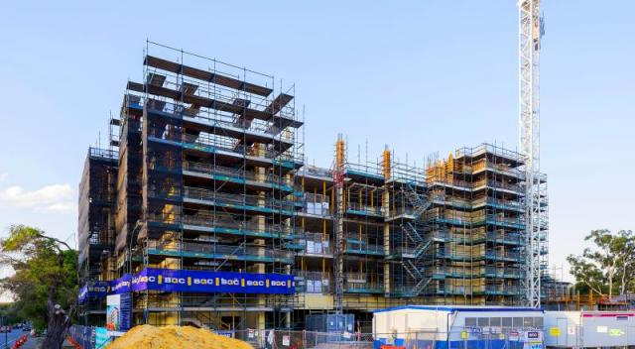
University of Western Australia
Indian Ocean Marine Research Centre
Notes:
Accommodation options include luxurious self-contained studios, as well as spacious one and two bedroom apartments — a perfect fit for one or many. Each room is well-appointed with a range of contemporary and functional features:
Daily complimentary buffet breakfast
Fully equipped kitchen
Television
Complimentary WiFi
Work desk
King, Queen or Twin rooms
On-site parking
En suite bathrooms
Laundry facilities
Conference facilities available

Slide 6
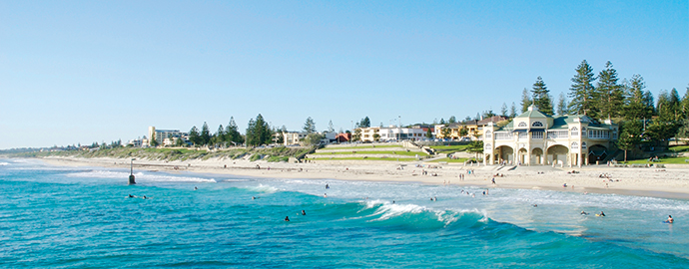
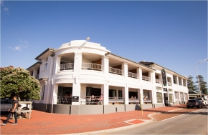
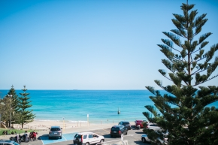
Cottesloe Beach Hotel

Slide 7
Price Comparisons
Option |  | Hotel Room (pppn) | Delegate Charge (lunch, tea breaks) | Other meeting room charges | Equipment charges | Other notes / conditions
Frasers | AUD USD | $180-$280 ~$130-$200 | $75 ~$55 | $500 ~$360 | $561* ~$400 | Min food / drink spend $2500
UWA | AUD USD | $180-$216 ~$130-$155 | $72 ~$50 | - | - | Could also use CSIRO / UWA rooms
Cottesloe | AUD USD | $200-$270 ~$140-$195 | $70 ~$50 | $750 ~$535 | $150** ~$110 | Only 13 rooms but other hotels nearby
* includes projector, screen, microphone, lectern, setup
** includes projector, screen only

Slide 8

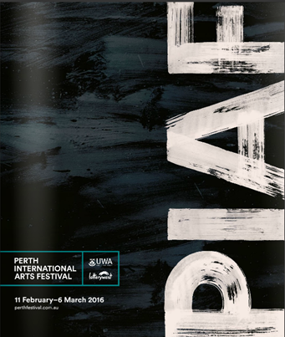



Logistics and Date Considerations
Access: direct flights from Dubai, Singapore, Hong Kong, South Africa, Sydney/Brisbane (for W Coast US connections)
Cultural features:
  Feb-Mar is Perth International Arts Festival and Fringe
  Great coffee, restaurants, wine
  No tipping
Date considerations:
  Perth Writers Festival at UWA (18 - 21/2?)
  IIOE-2/IOGOOS/IOP/SIBER (30/1 - 3/2)
Weather: hottest time of year (25-40°C),
v low chance of rain but possible occasional storms

Slide 9
